Slide 1
Diamonds’ Price
Prediction Project
Anas abdullah (L)
Abdullah al-nemrat
Omar Abu-Rish

Slide 2
Feature of diamonds project
We have eleven feature , where each feature represents the following :
Carat : carat weight of the diamonds .
Cut : Describe cut quality of the diamond. Quality in increasing order Fair, Good, Very Good, Premium, Ideal .
Color : Color of the diamond, with D being the best and J the worst .
Clarity : How obvious inclusions are within the diamond:(in order from best to worst, FL = flawless, I3= level 3 inclusions) FL,IF, VVS1, VVS2, VS1, VS2, SI1, SI2, I1, I2, I3
Depth : The height of a diamond, measured from the culet to the table, divided by its average girdle diameter.
Tabel : The width of the diamond's table expressed as a percentage of its average diameter.
Price : The price of the diamonds .
X : Length mm .
Y : width mm .
Z : Depth mm .
Unnamed: 0 : Index counter .

Slide 3
Project stages
01
03
02
04
Overview
Split data and create pipeline
Transform the data
Find best model and Fine-Tune

Slide 4

INTRODUCTION
In this project, you will build a machine learning model to predict diamonds prices .
We walk through the different steps of the building process: read and visualizing the data. Then, cleaning and data modification. Finally, selecting the best model and model evaluation.

Slide 5
01
OVERVIEW

Slide 6
Show the data
After applying describe(), info() and isna().sum() we figured that there are no missing data, and also we have three object columns and that there are outlier values.

Slide 7
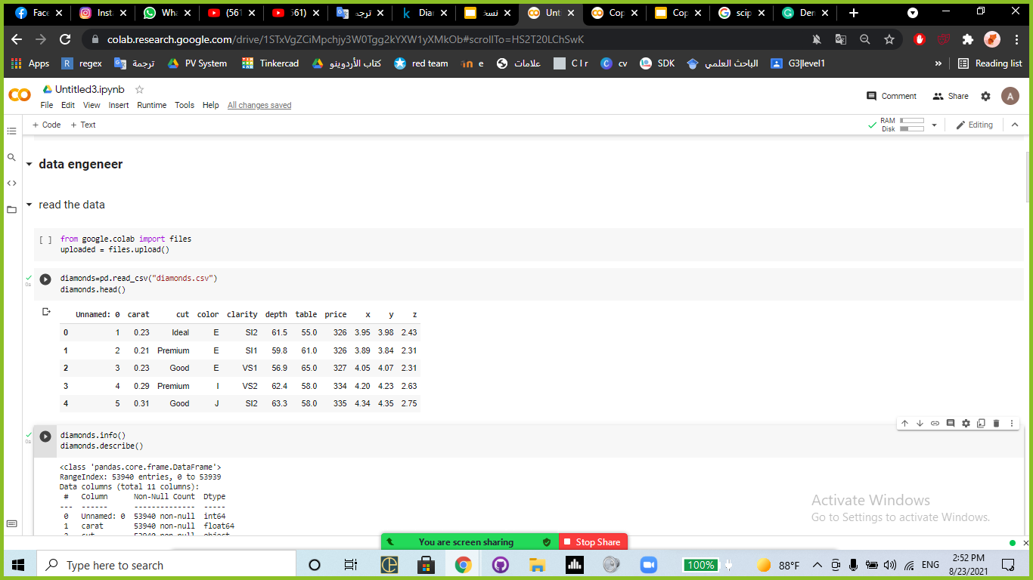
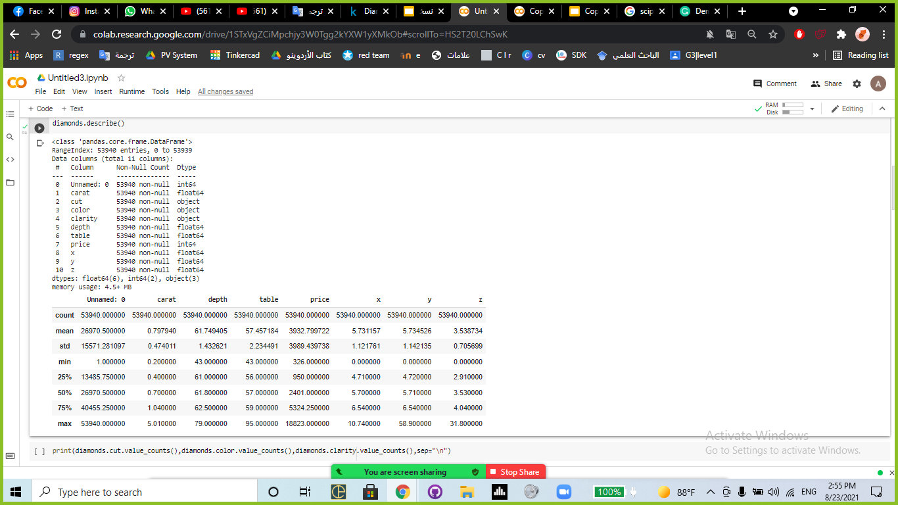

Slide 8
02
Transform the data

Slide 9
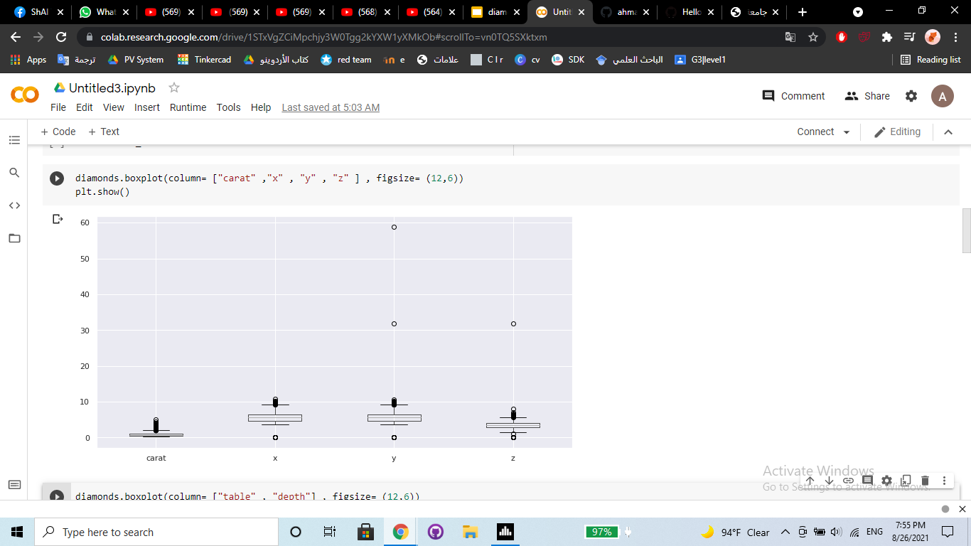
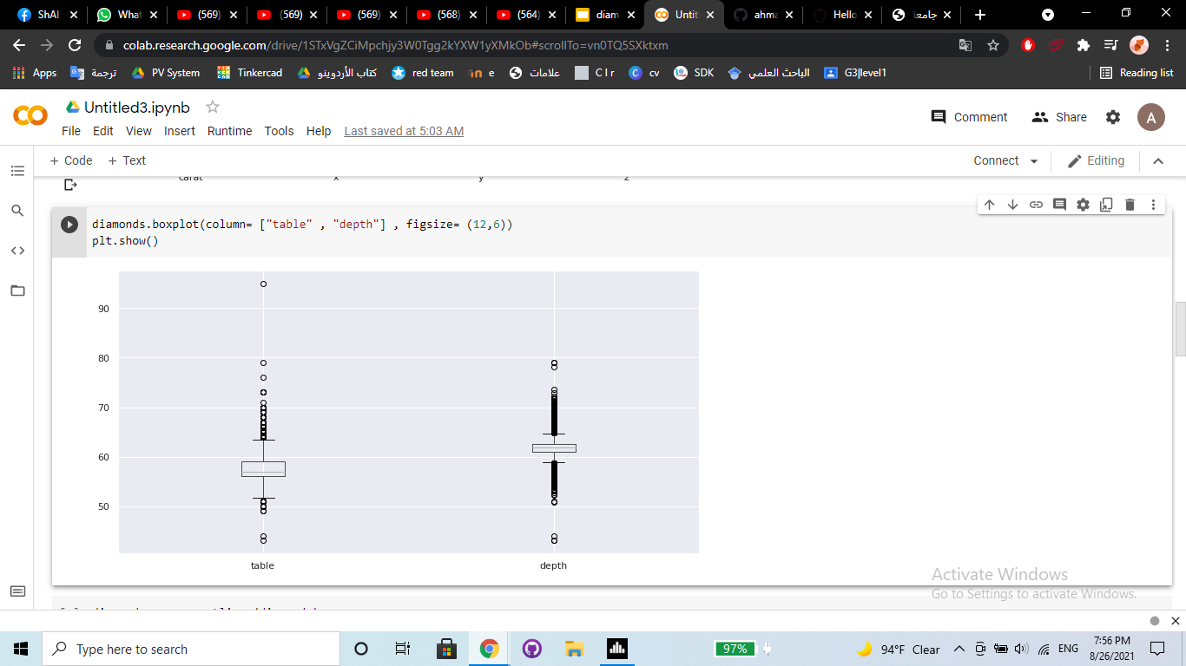
Before

Slide 10
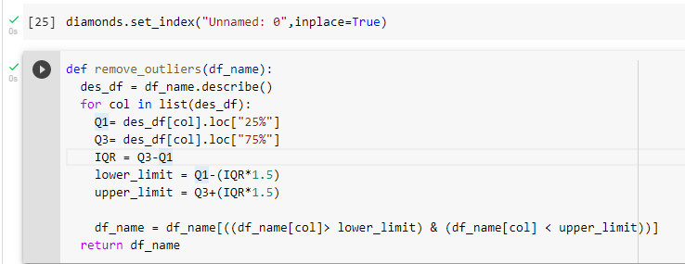
The first thing we do is set_index(), and then we remove outliers from data :

Slide 11
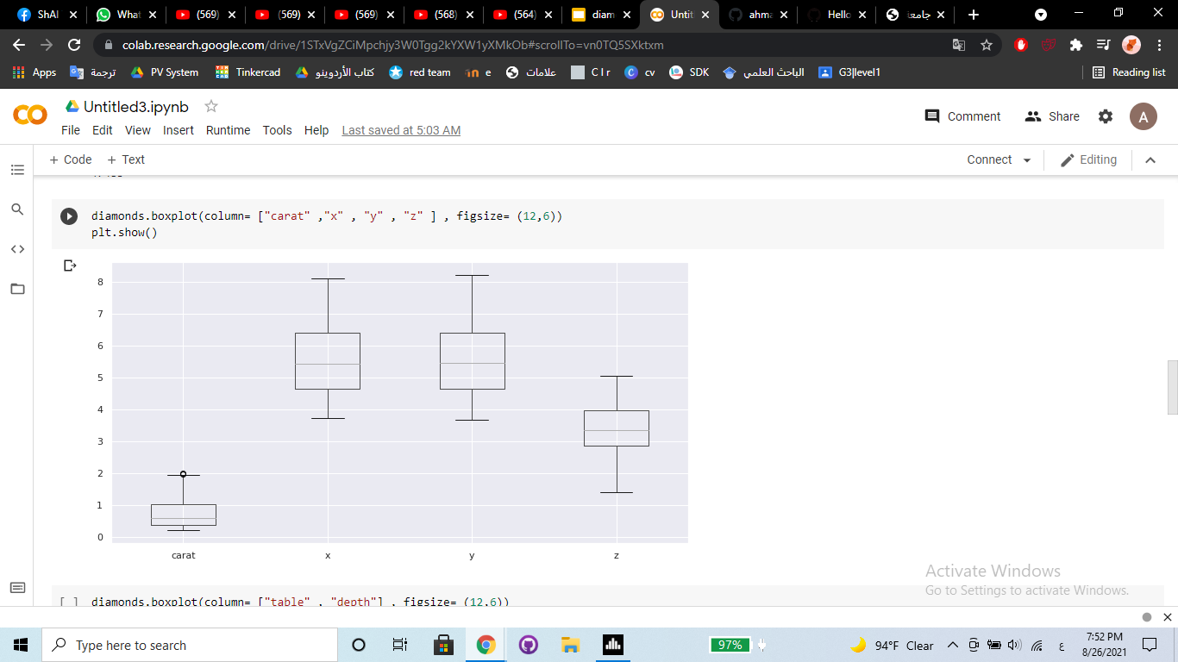
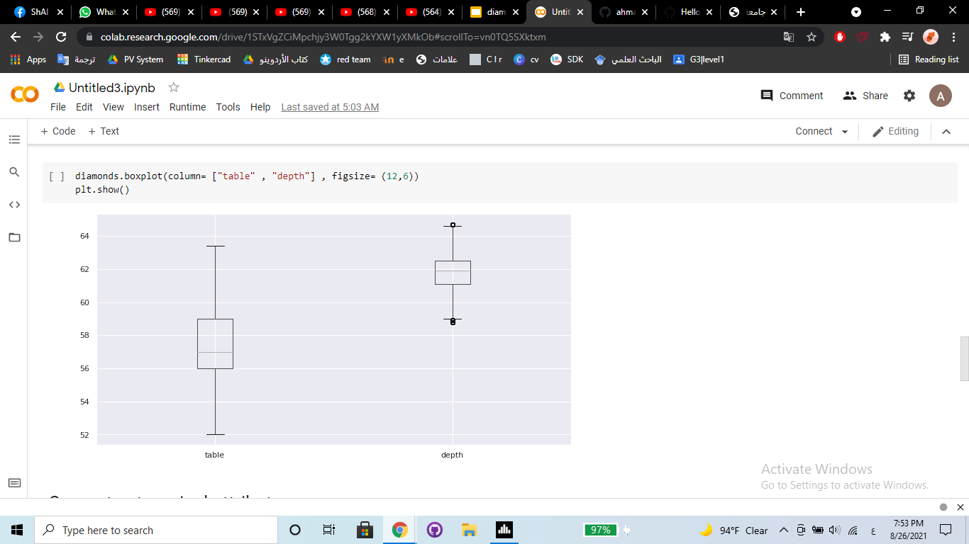
After

Slide 12
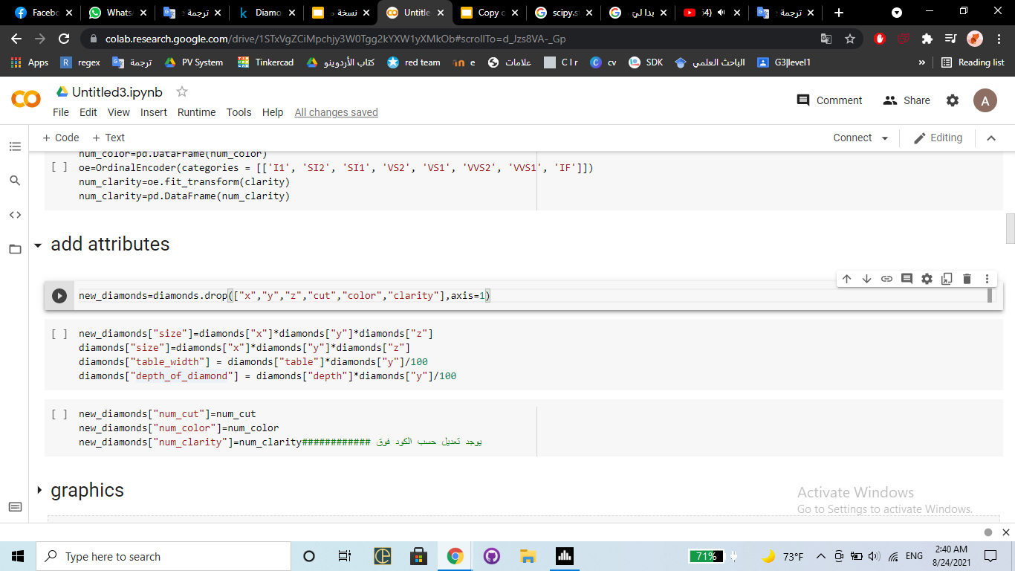
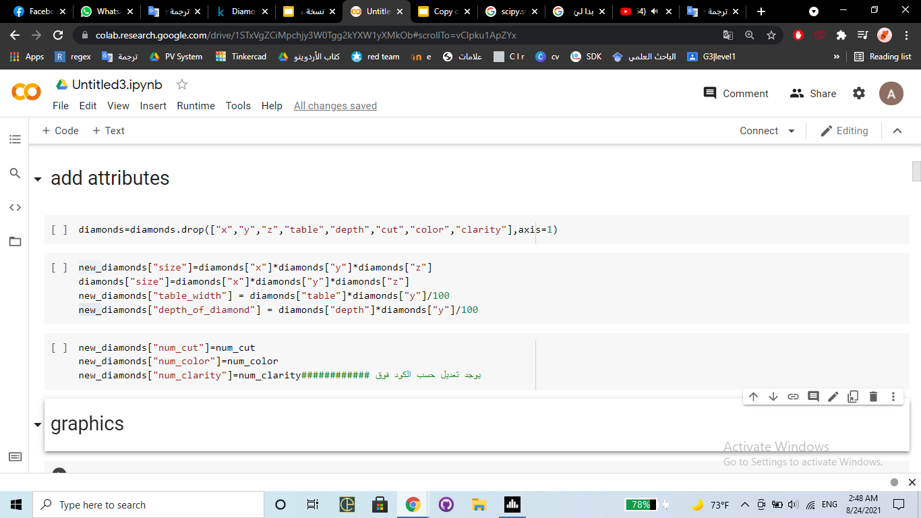
After thinking about adding some features, we found some results :
Size = x * y * z
Table_width = table * y / 100
Depth_of_diamond = depth * y / 100
and delete some features :
X
Y
Z
Table
Depth
Cut , color , clarity

Slide 13
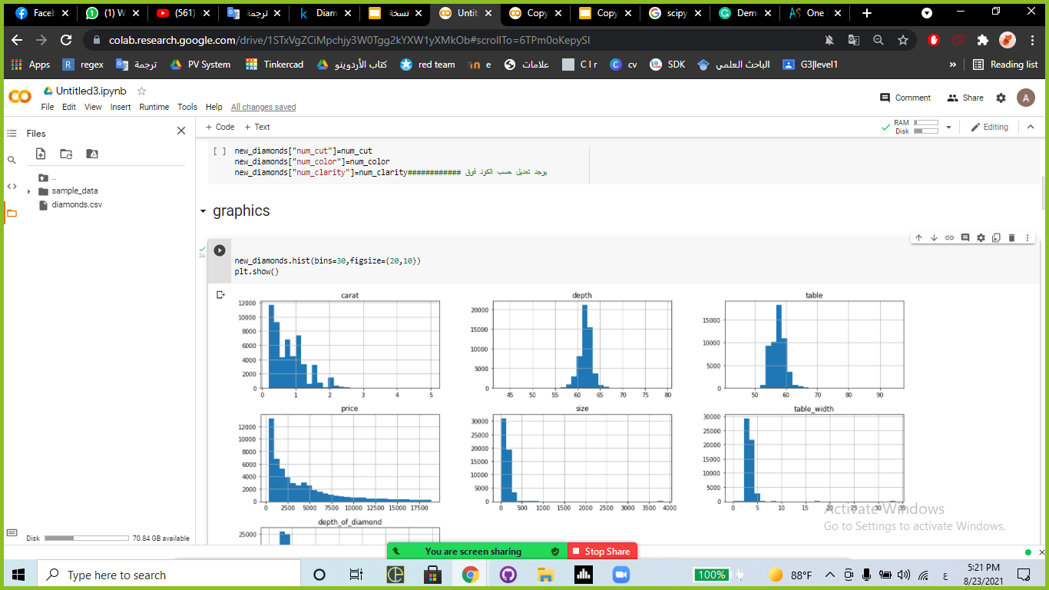
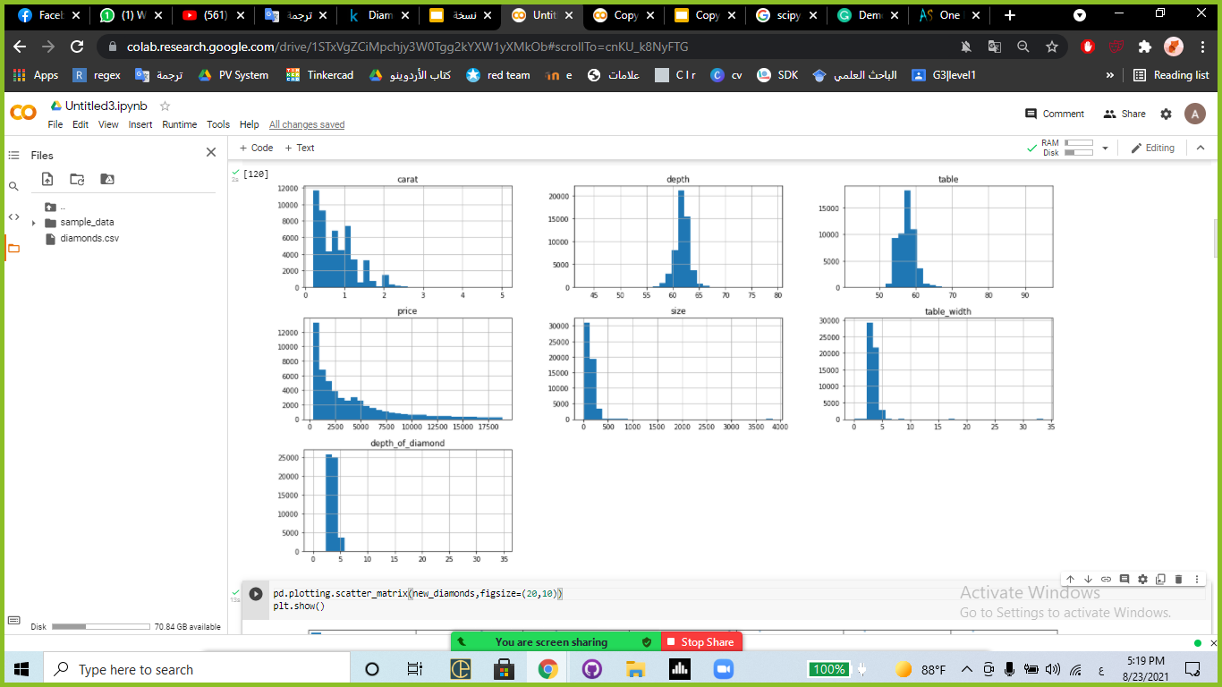

Slide 14
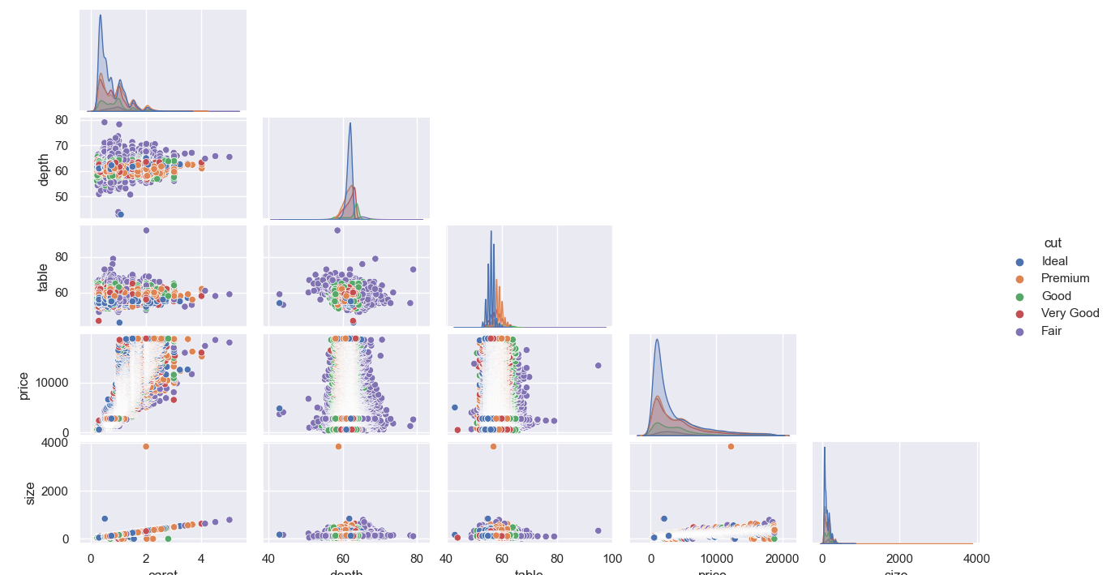
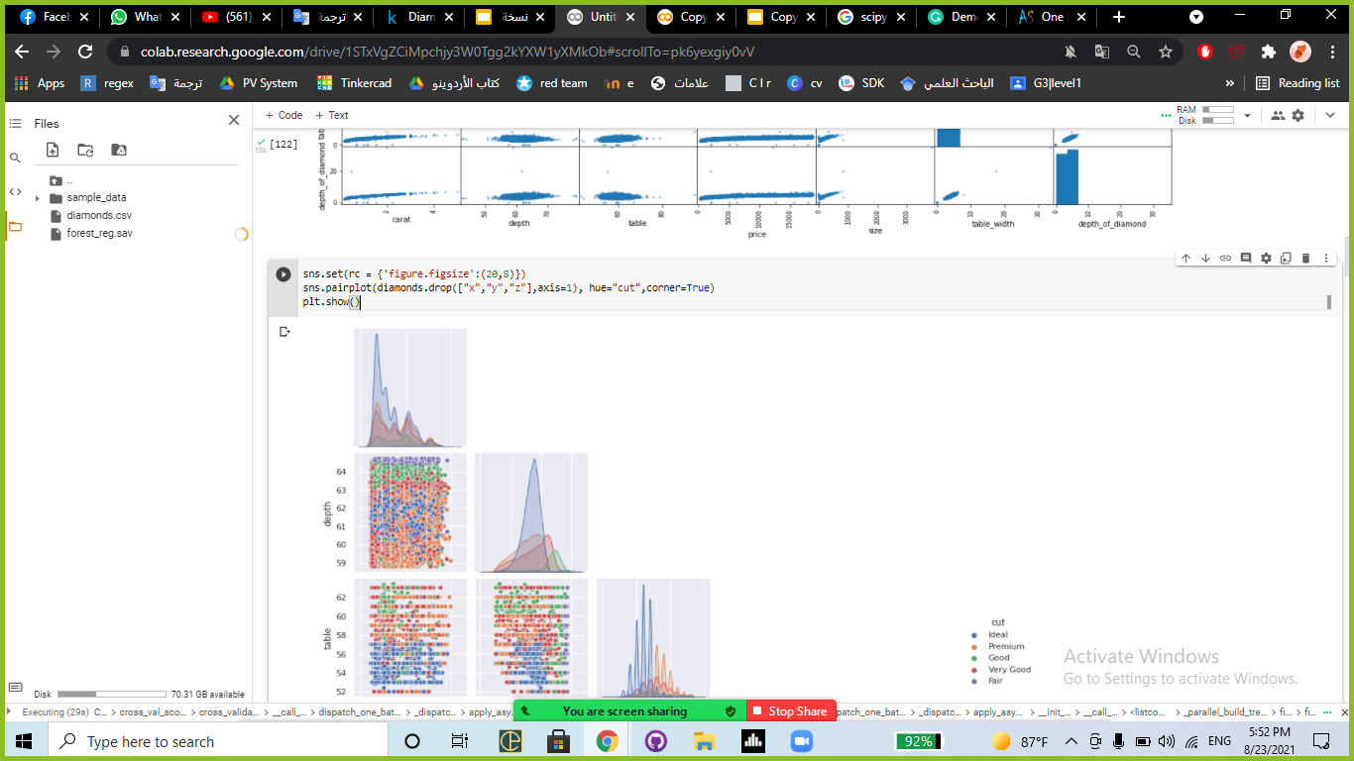

Slide 15
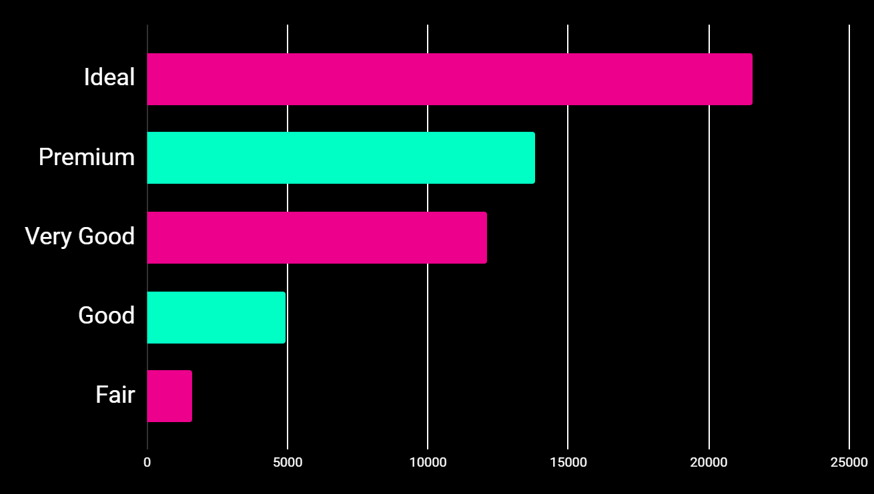
Cut value counts

Slide 16
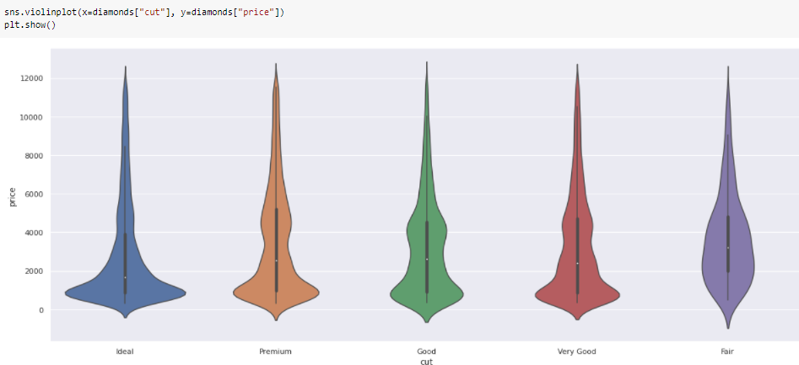

Slide 17
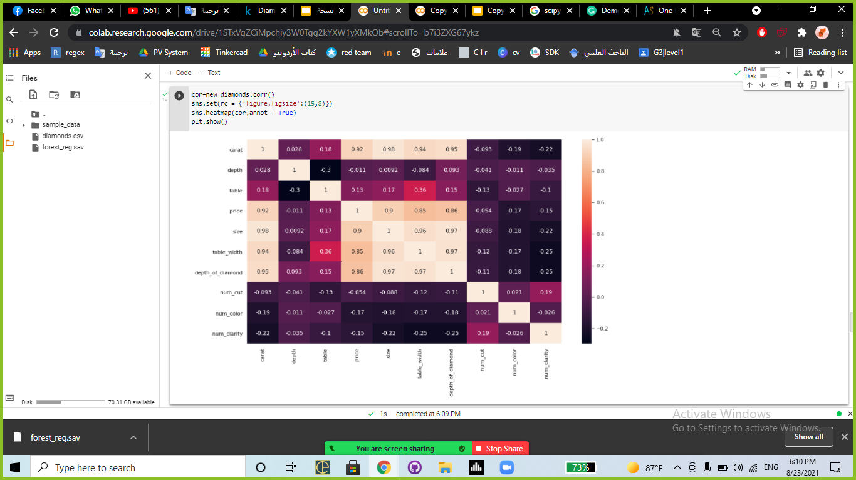

Slide 18
03.1
Split data

Slide 19
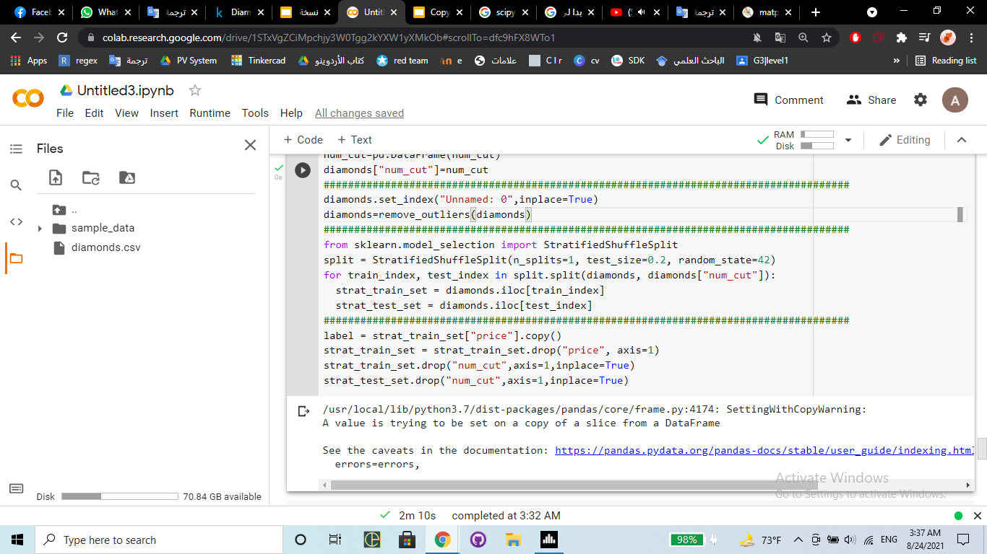
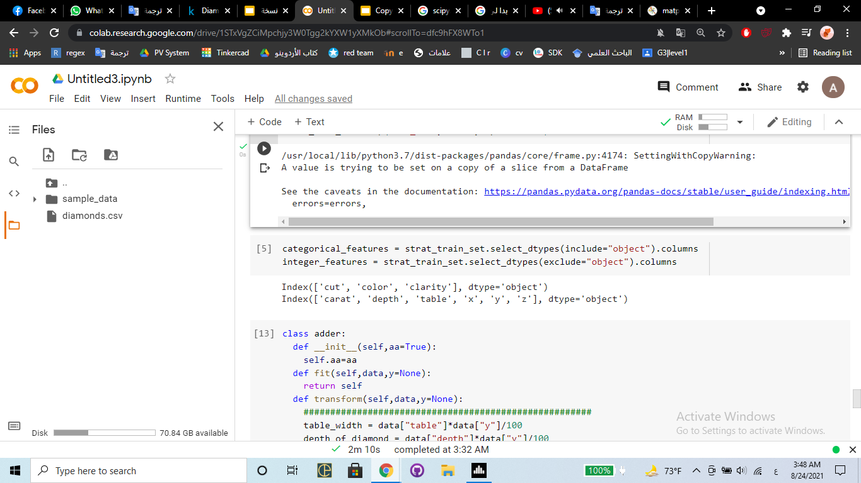
From the previous figure we Decided to split the data by cut, we used the function StratifiedShuffleSplit :

Slide 20
03.2
create pipeline

Slide 21
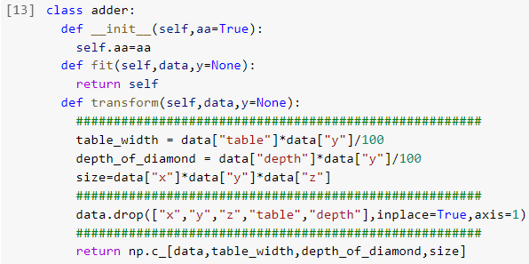
First we must build a class that will allow us to add and remove features :

Slide 22
Full pipeline
Class we are build
By testing
attribs_adder
Ordinal Encoder
standard_scaler
By categories we put it

Slide 23
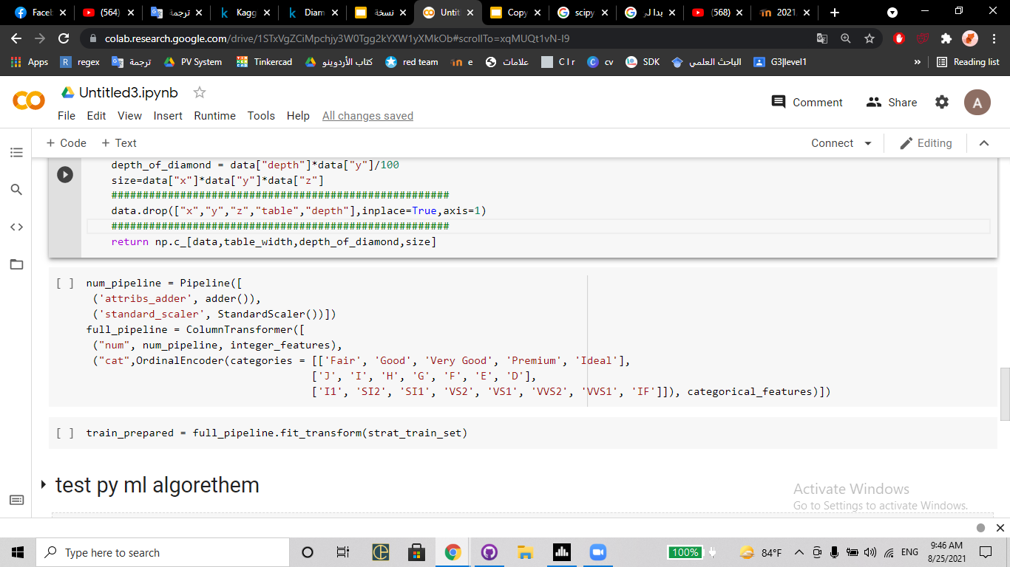
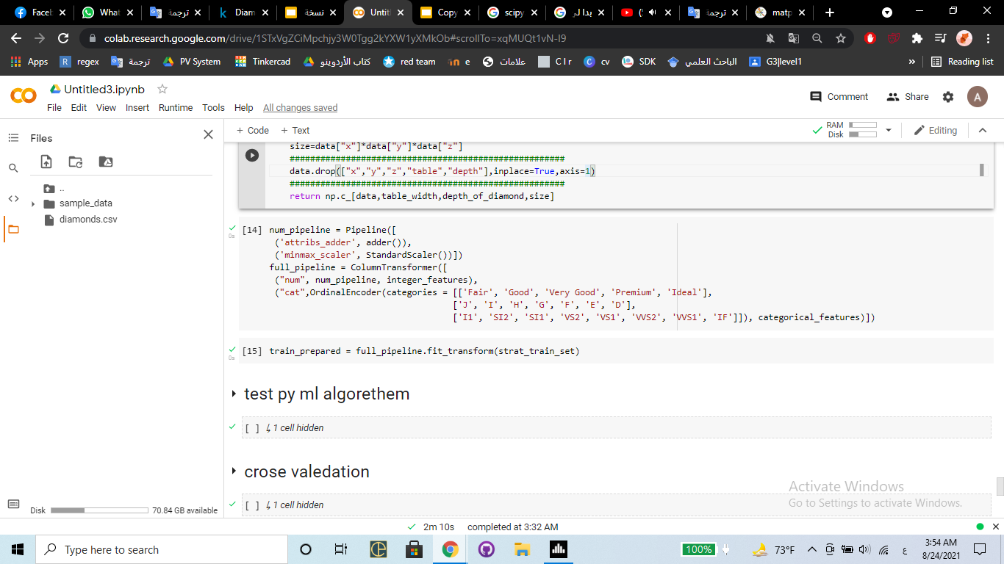
Then we build the pipeline in two stages (the first for digital features, and the second for object features) :

Slide 24
04.1
Find best model

Slide 25
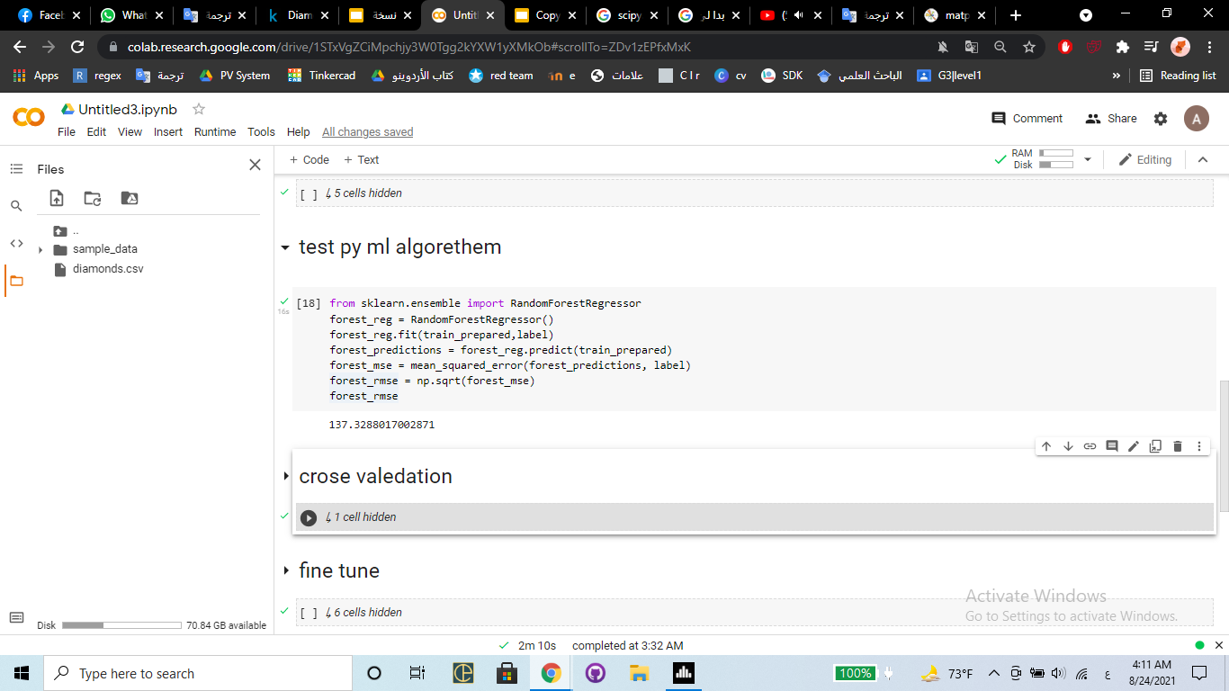
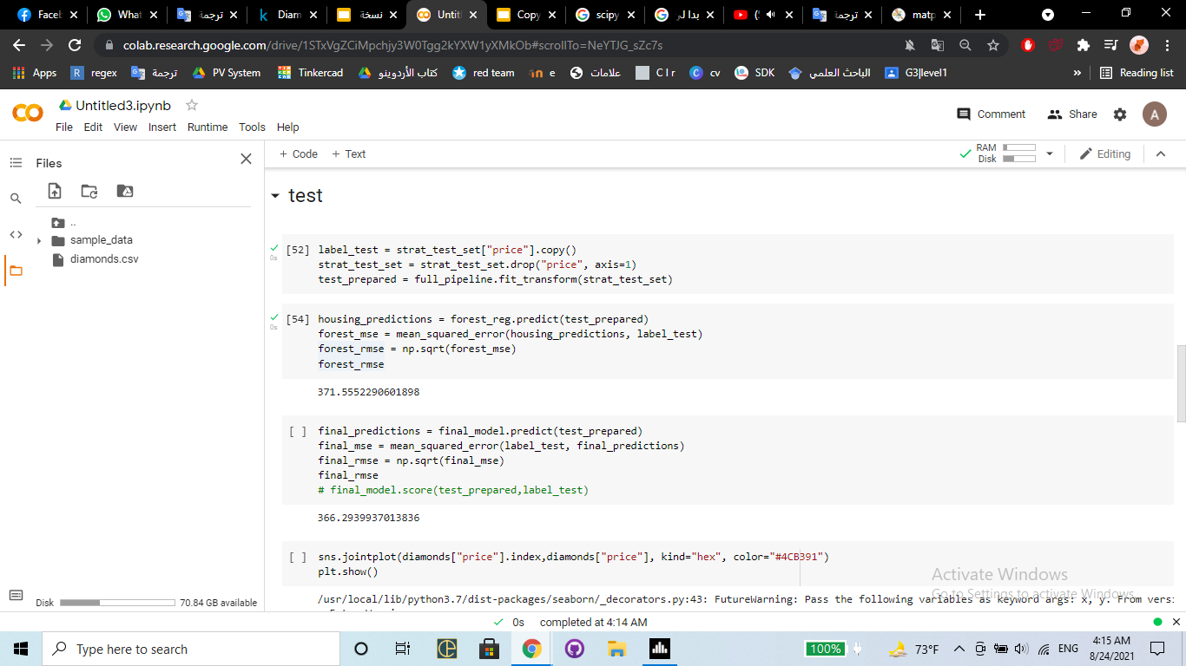
After trying a lot of models, we didn't find a better model than the RandomForestRegressor model :
Test the model in test data :

Slide 26
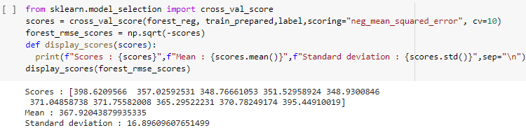
We judge it was the best after running the function cross validation :

Slide 27
04.2
Fine-Tune

Slide 28
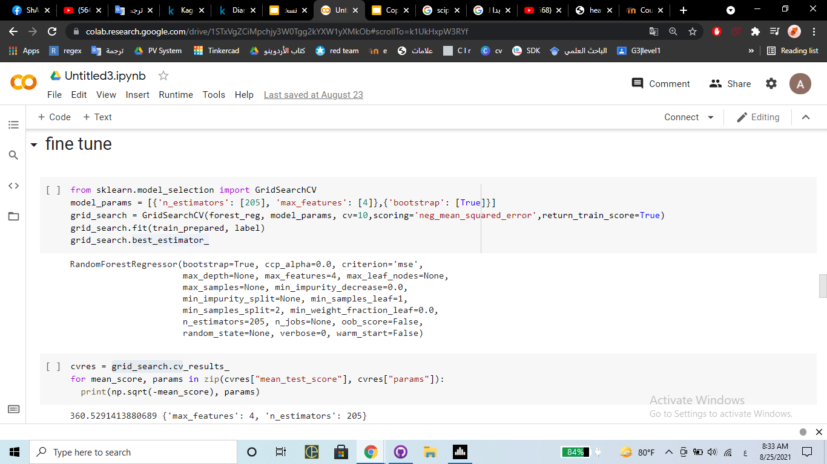
To improve the model through a hyperparameter, we use the GridSearchCV
After testing, we found that this is the best parameter :

Slide 29
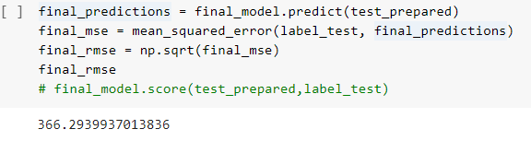
After applying the final_model to the test data and finding the Root_Mean_Square_Error, we got this result :

Slide 30
98.2%
The accuracy we finally got

Slide 31
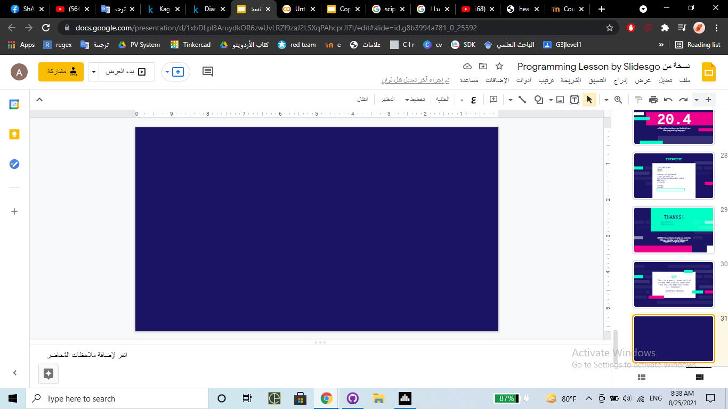
THANKS!
Anas abdullah (L)
Abdullah al-nemrat
Omar Abu-Rish

